Slide 1
Nourriture - Connect People with Ingredients
fastDev@Agile_Scrum
Beijing Jiao Tong University

Slide 2
Agile vs. Scrum
Scrum is just one of the many iterative and incremental agile software development method.
Scrum, Kanban, etc are the well known methods that applied in agile software development.
Beijing Jiao Tong University

Slide 3
What Agile Software Development
"Agile software development" refers to a group of software development methodologies based on iterative development, where requirements and solutions evolve via collaboration between self-organizing and cross-functional teams.
The term was coined in the year 2001 when the Agile Manifesto was formulated.
Individuals and interactions over Processes and tools
Working software over Comprehensive documentation
Customer collaboration over Contract negotiation
Responding to change over Following a plan
Beijing Jiao Tong University

Slide 4
Manifesto within SW Development Context
Individuals and interactions
-- In agile development, self-organization and motivation are important, as are interactions like co-location and pair programming.
Working software
-- Working software will be more useful and welcome than just presenting documents to clients in meetings.
Customer collaboration
-- Requirements cannot be fully collected at the beginning of the software development cycle, therefore continuous customer or stakeholder involvement is very important.
Responding to change
-- Agile development is focused on quick responses to change and continuous development.
Beijing Jiao Tong University

Slide 5
What Scrum
Scrum is an iterative and incremental agile software development framework
It enables teams to self-organize by encouraging physical co-location or close online collaboration of all team members, as well as daily face-to-face communication among all team members and disciplines in the project.
The key principle is that during a project the customers can change their minds about what they want and need (often called "requirements churn"), because requirements are hard to be addressed by customers.
-- Scrum adopts an empirical approach: accepting that the problem cannot be fully understood or defined, focusing instead on maximizing the team's ability to deliver quickly and respond to emerging req.
Beijing Jiao Tong University

Slide 6
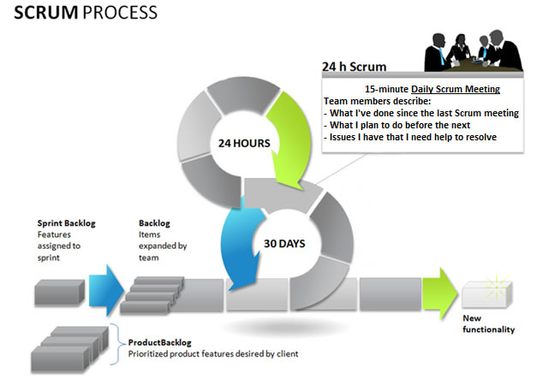
Scrum Process Overview
Suggested tool to manage the below stuff
https://trello.com/
-- Product Backlog Items
-- Sprint Backlog
-- Backlog Item
Beijing Jiao Tong University

Slide 7
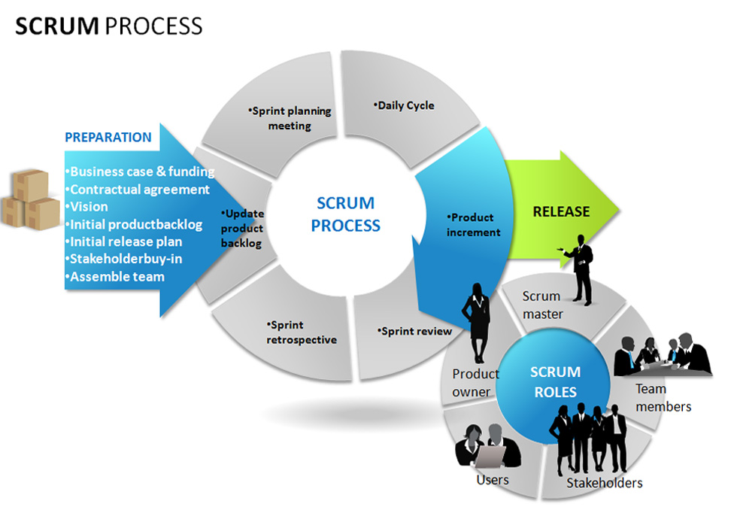
The Steps of Scrum Process
Backlog refinement
-- This process allows all team members to share thoughts and concerns, and properly understand the workflow.
Sprint planning
-- Every iteration starts with a sprint planning meeting. The product owner holds a conversation with the team and decides which stories are highest in priority, and which ones they will tackle first. Stories are added to the sprint backlog, and the team then breaks down the stories and turn them into tasks.
Daily Scrum
-- The daily scrum is also known as the daily standup meeting. This serves to tighten communication and ensure that the entire team is on the same page. Each member goes through what they have done since the last standup, what they plan to work on before the next one, and outline any obstacles.
Sprint review meeting
-- At the end of a sprint, the team presents their work to the product owner. The product owner goes through the sprint backlog and either accepts or rejects the work. All uncompleted stories are rejected by the product owner.
Sprint retrospective meeting
-- Finally, after a sprint, the scrum master meets with the team for a retrospective meeting. They go over what went well, what did not, and what can be improved in the next sprint. The product owner is also present, and will listen to the team lay out the good and bad aspects of the sprint. This process allows the entire team to focus on its overall performance and identify strategies for improvement. It is crucial as the ScrumMaster can observe common impediments and work to resolve them.
Beijing Jiao Tong University

Slide 8
The Major Diff. from Other Methodologies
Scrum has three roles: Product owner, team members, scrum master.
Projects are divided into sprints, which typically last one, two or three weeks.
At the end of each sprint, all stakeholders meet to assess the progress and plan its next steps.
The advantage of scrum is that a project’s direction to be adjusted based on completed work, not on speculation or predictions.
Beijing Jiao Tong University

Slide 9
Benefit of Scrum
Benefits to Customer
-- Customers find that the vendor is more responsive to development requests. High-value features are developed and delivered more quickly with short cycles, than with the longer cycles favored by classic “waterfall” processes.
Benefits to Vendors
-- Vendors reduce wastage by focusing development effort on high-value features, and reduce time-to-market relative to waterfall processes due to decreased overhead and increased efficiency. Improved customer satisfaction translates to better customer retention and more positive customer references.
Benefits to Development Teams
-- Team members enjoy development work, and like to see their work used and valued. Scrum benefits Team members by reducing non-productive work (e.g., writing specifications or other artifacts that no one uses), and giving them more time to do the work they enjoy. Team members also know their work is valued, because requirements are chosen to maximize value to customers.
Benefits to Product Managers
-- Product Managers, who typically fill the Product Owner role, are responsible for making customers happy by ensuring that development work is aligned with customer needs. Scrum makes this alignment easier by providing frequent opportunities to re-prioritize work, to ensure maximum delivery of value.
Benefits to Project Managers
-- Project Managers (and others) who fill the ScrumMaster role find that planning and tracking are easier and more concrete, compared to waterfall processes. The focus on task-level tracking, the use of Burndown Charts to display daily progress, and the Daily Scrum meetings, all together give the Project Manager tremendous awareness about the state of the project at all times. This awareness is key to monitoring the project, and to catching and addressing issues quickly.
Beijing Jiao Tong University

Slide 10
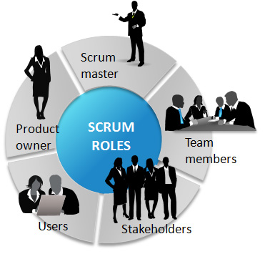
Roles “Scrum Team,” refers to the Team plus the ScrumMaster and Product Owner.
The Product Owner is the keeper of the requirements.
-- The single contact for all questions about product req.
-- Works closely with the team to define the user-facing and technical requirements, to document the requirements as needed, and to determine the order of their implementation.
-- Maintains the Product Backlog (which is the repository for all of this information), keeping it up to date and at the level of detail and quality the Team requires.
The Team is a self-organizing group of people who do the hands-on work of developing and testing the product.
-- Team members decide how to break work into tasks, and how to allocate tasks to individuals, throughout the Sprint.
The ScrumMaster (sometimes written “Scrum Master,” although the official term has no space after “Scrum”) is the keeper of the process.
-- Making the process run smoothly,
-- Removing obstacles that impact productivity
-- Improving the engineering practices and tools
-- Keeping information about the Team’s progress up to date and visible to all parties
Notice: The ScrumMaster does not assign tasks to Team members, as task assignment is a Team responsibility. His general approach towards the Team is to encourage and facilitate their decision-making and problem-solving capabilities
Beijing Jiao Tong University

Slide 11
Requirements
Scrum does not define just what form requirements are to take, but simply says that they are gathered into the Product Backlog, and referred to generically as “Product Backlog Items,” or “PBIs” for short.
Most Scrum projects borrow the “XP” (Extreme Programming) practice of describing a feature request as a “User Story”.
Beijing Jiao Tong University

Slide 12
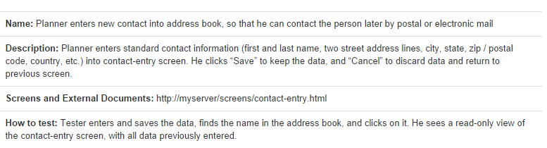
What User Story
A User Story describes a desired feature (functional requirement) in narrative form. User Stories are usually written by the Product Owner, and are the Product Owner’s responsibility.
Let’s take an example as below
Beijing Jiao Tong University

Slide 13
The Elements in User Story
Name
-- The example uses a basic “Role-Action-Reason” organization.
-- Another common style, popularized by Mike Cohn, follows the template “As a <type of user>, I want <some goal> so that <some reason>.”
Description
-- This is a high-level (low-detail) description of the need to be met.
For functional (user-facing) requirements, the description is put in narrative form.
For non-functional requirements, the description can be worded in any form.
Notice: In both cases, the key is that the level of detail is modest, because the fine details are worked out during the implementation phase, in discussions between team members, product owners, and anyone else who is involved. (This is one of the core concepts of Scrum)
Screens and External Documents
-- If the Story requires user-interface changes (especially non-trivial ones), the Story should contain or link to a prototype of the changes or any external documents required to implement the Story should also be listed.
How to test
-- This section provides a brief description of how the story will be tested. The implementation of a Story is defined to be complete if, and only if, it passes all acceptance tests developed for it.
Beijing Jiao Tong University

Slide 14
The Defect
A Defect, or bug report, is a description of a failure of the product to behave in the expected fashion.
Defects are stored in a bug-tracking system, which may or may not be physically the same system used to store the Product Backlog. If not, then someone (usually the Product Owner) must enter each Defect into the Product Backlog, for sequencing and scheduling.
Suggested tool as proprietary:
JIRA: https://www.atlassian.com/software/jira/try/
Suggested tool as open source:
Redmine: http://www.redmine.org/projects/redmine/wiki/Download
Bugzilla: http://www.bugzilla.org/download/
Beijing Jiao Tong University

Slide 15
Reference
https://www.cprime.com/resources/what-is-agile-what-is-scrum/
http://www.onedesk.com/2013/06/scrum-methodology-vs-agile-methodology/
http://en.wikipedia.org/wiki/Scrum_(software_development)
http://en.wikipedia.org/wiki/Agile_software_development
Beijing Jiao Tong University

